Slide 1
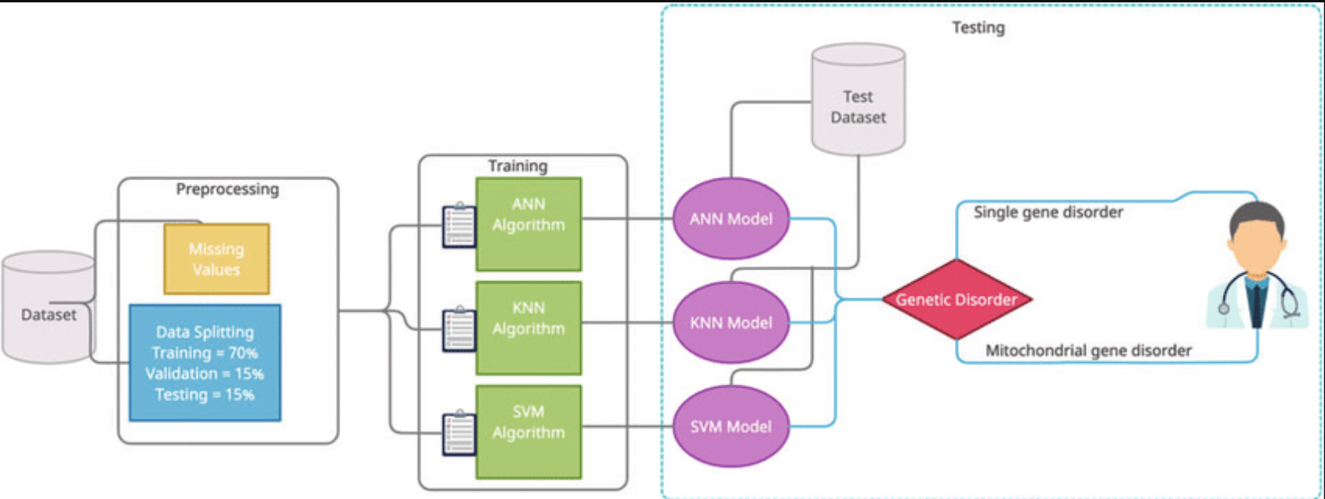
Machine Learning
Genes Disorder Prediction Model

Slide 2
AIM OF PROJECT
A genetic disorder prediction model using machine learning aims to accurately predict the likelihood of an individual developing a particular genetic disorder based on their genetic data and possibly other relevant factors such as lifestyle, environmental exposure, and family history.
Results from clinical tests, including genetic-based predictive models, are useful when they more accurately discern the likelihood of the medical trait (e.g., disease occurrence or response to medication), compared to the pre-test assessment.
the goal of a genetic disorder prediction model is to assist healthcare professionals in early detection and intervention, thereby improving patient outcomes and quality of life.

Slide 3
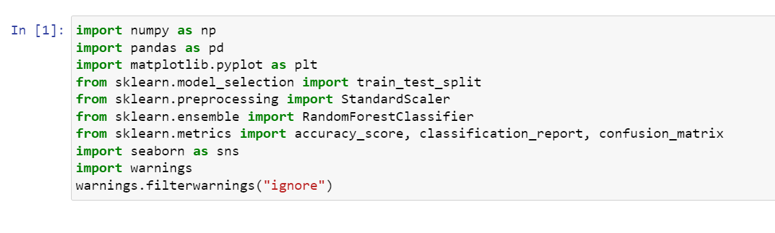
IMPORTING THE LIBRARIES
In machine learning, libraries are essential tools that provide pre-built functions and algorithms for various tasks such as data preprocessing, model building, evaluation, and visualization.

Slide 4
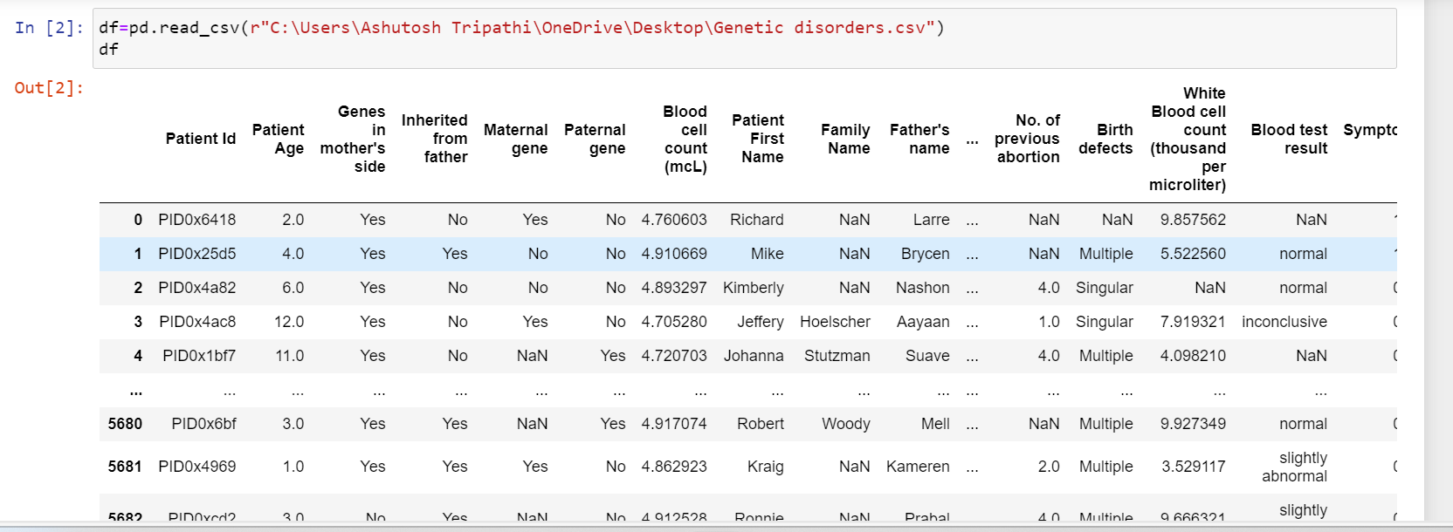
IMPORTING DATASET
The first step is to gather a large dataset containing genetic information from individuals who have been diagnosed with various genetic disorders, as well as information from healthy individuals. This dataset should also include other relevant features such as age, gender, ethnicity, family history, lifestyle factors, and environmental exposures.

Slide 5
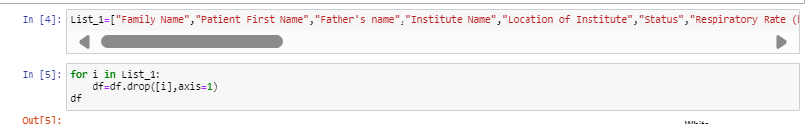
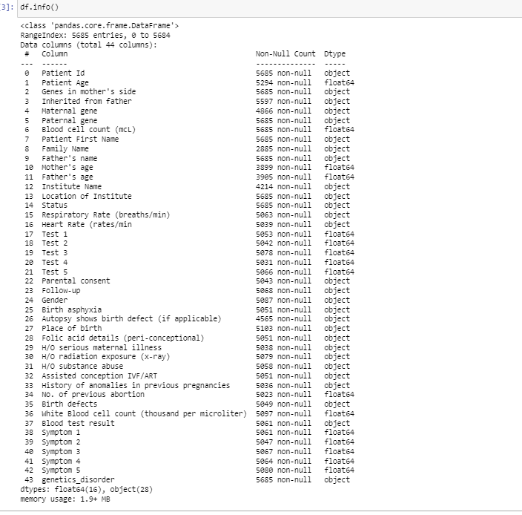
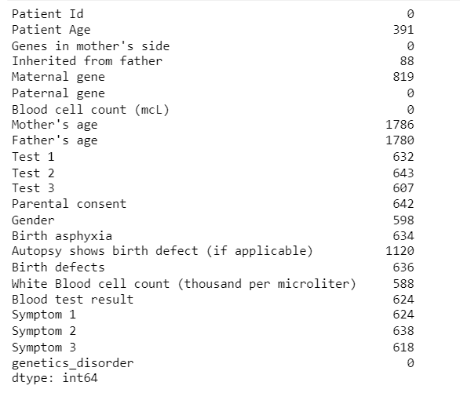
Dropping unwanted columns from the dataset

Slide 6
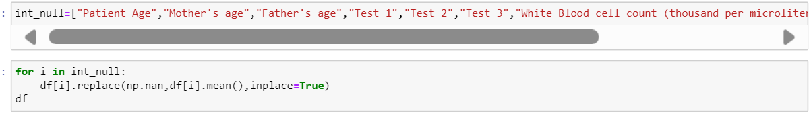
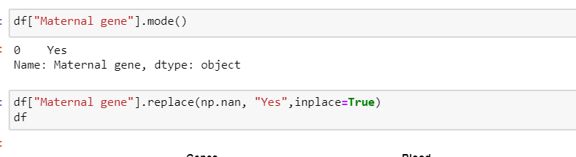
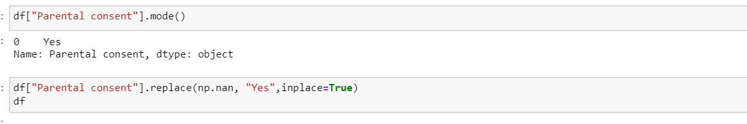
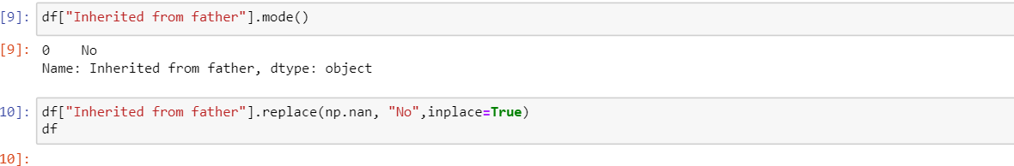
Finding null values and replacing it from dataset by making list of null values Handling missing values by filling it with mean and mode using fillna function change Data Types to integer

Slide 7
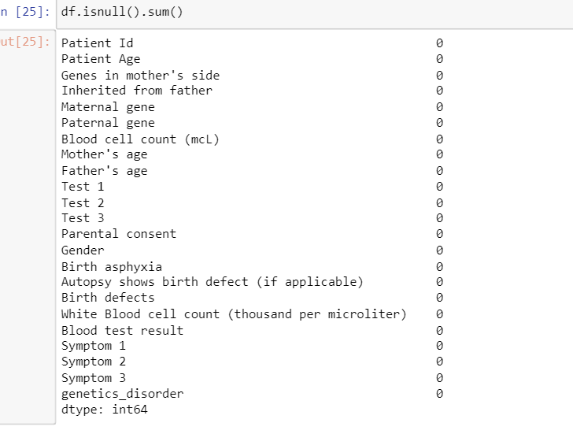
The collected data needs to be cleaned and preprocessed to remove any noise or inconsistencies. This may involve tasks such as imputing missing values, normalizing the data, and encoding categorical variables.
It is observed that the dataset contains null values, which is futher replaced using mean and mode function.
Following are the images of before Data cleaning and after cleaned data:-
It

Slide 8
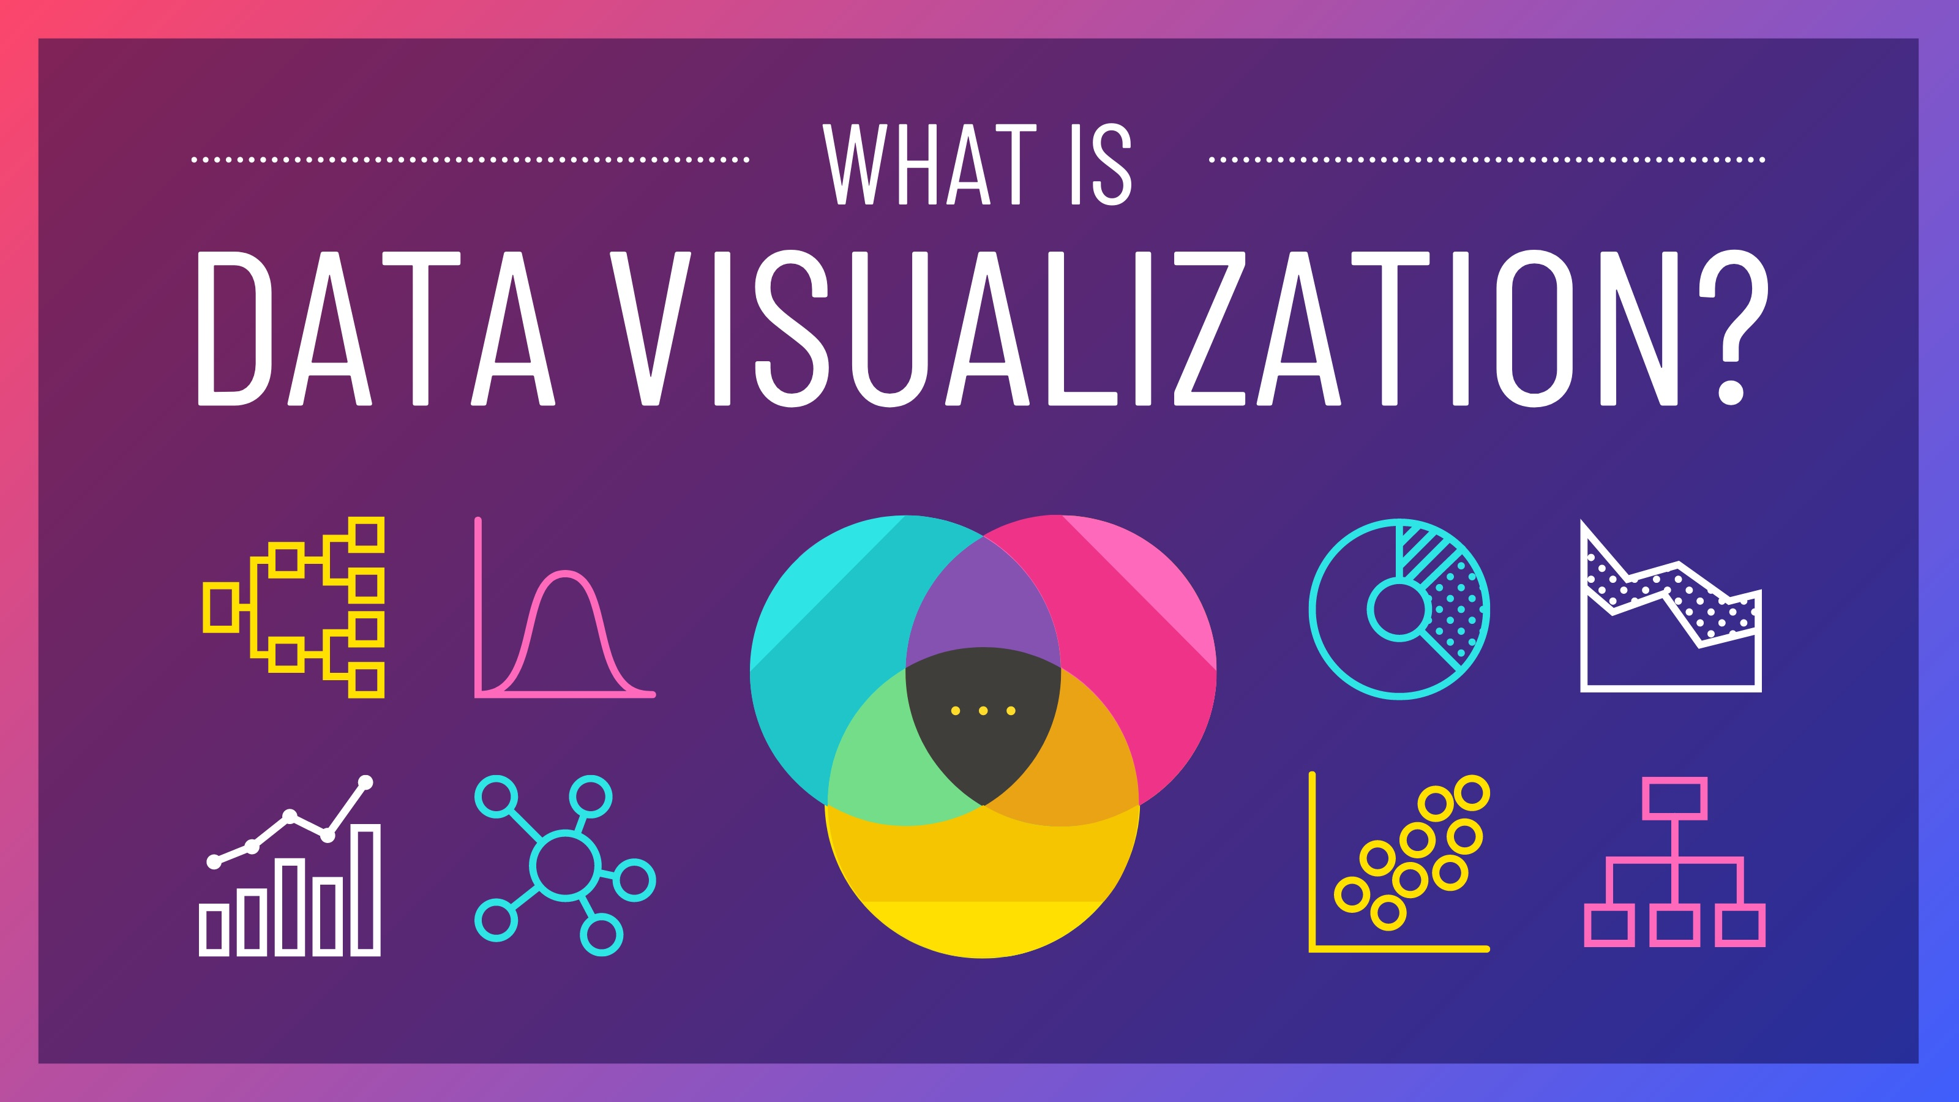
VISUALISATION OF DATA
Visualization of data is an essential aspect of Exploratory Data Analysis (EDA) in machine learning. It helps in understanding the underlying patterns, relationships, and distributions within the dataset.

Slide 9
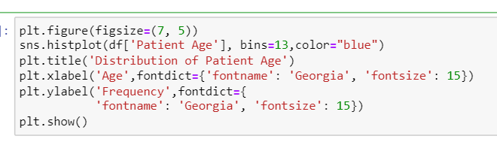
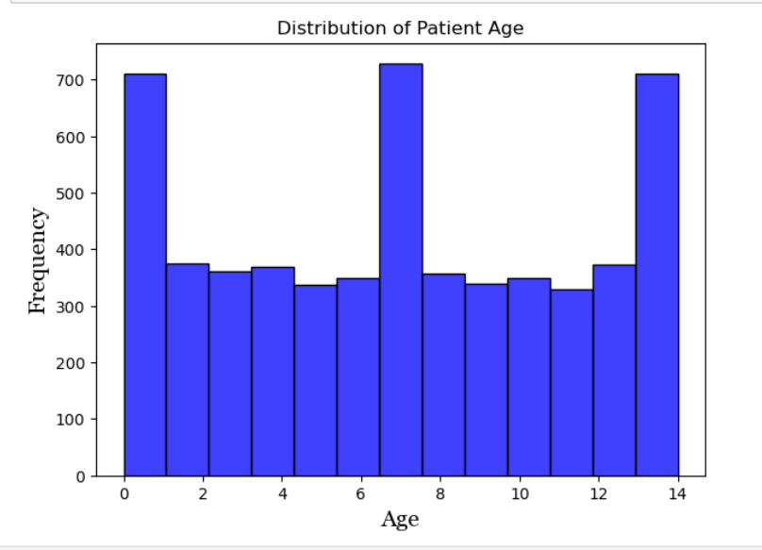
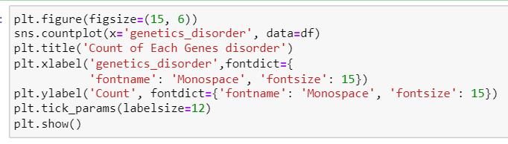
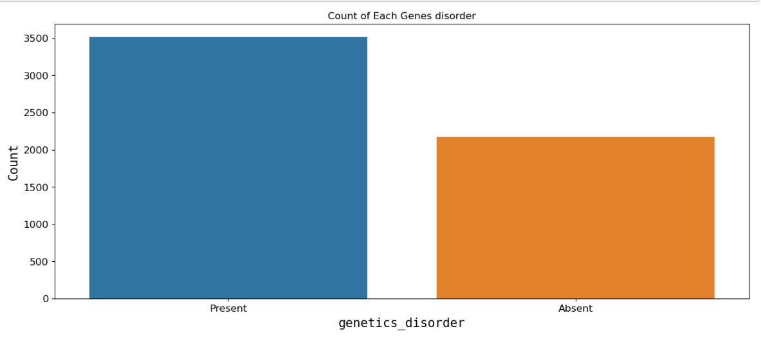
Following graph is created by using histplot and countplot.In the first graph we are distributing the age of patients, and in the second graph we are distributing the patients as if the disorder is present in them or not.

Slide 10
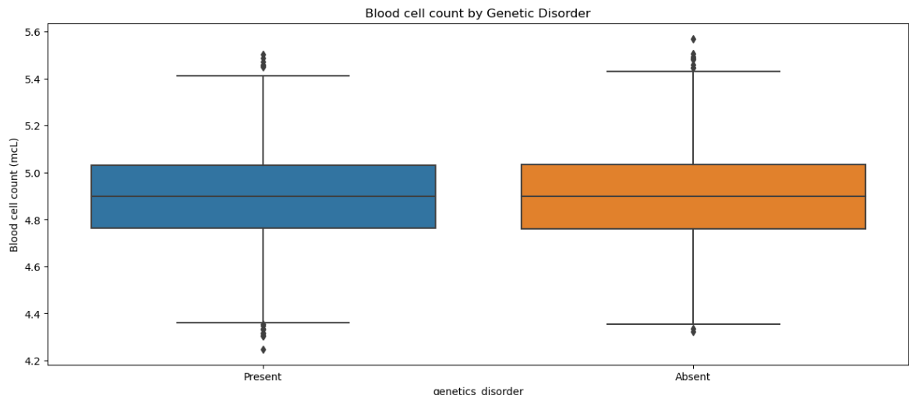
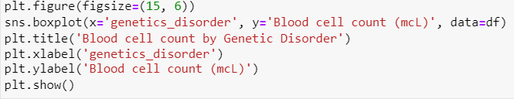
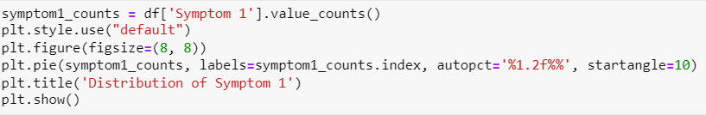
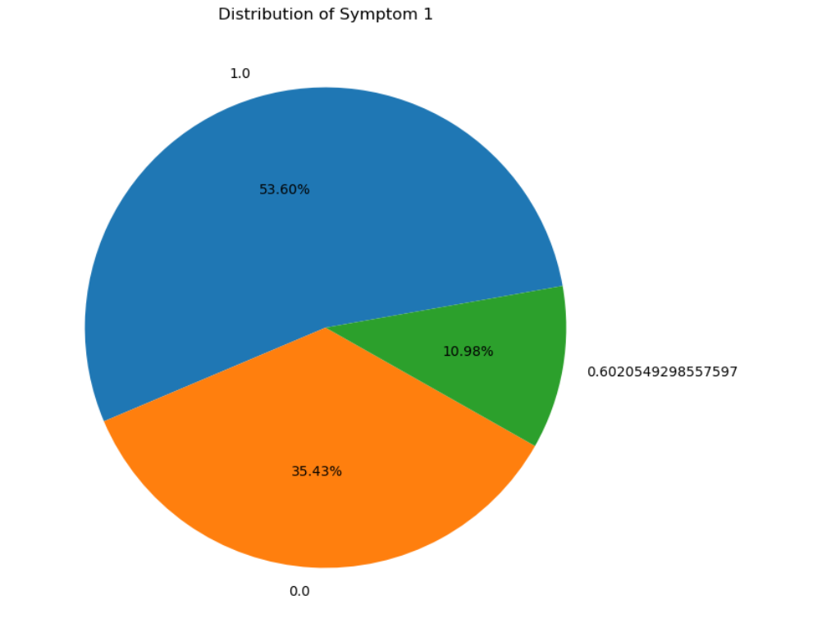
This first code snippet uses Matplotlib and Seaborn to create a box plot visualization showing the distribution of blood cell counts for different genetic disorders.
The second code creates pie chart visualization showing the distribution of occurrences of different symptoms (Symptom 1) in the DataFrame 'df

Slide 11
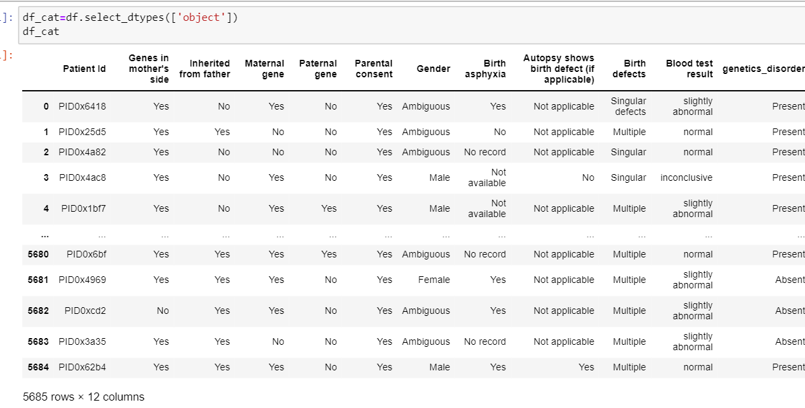
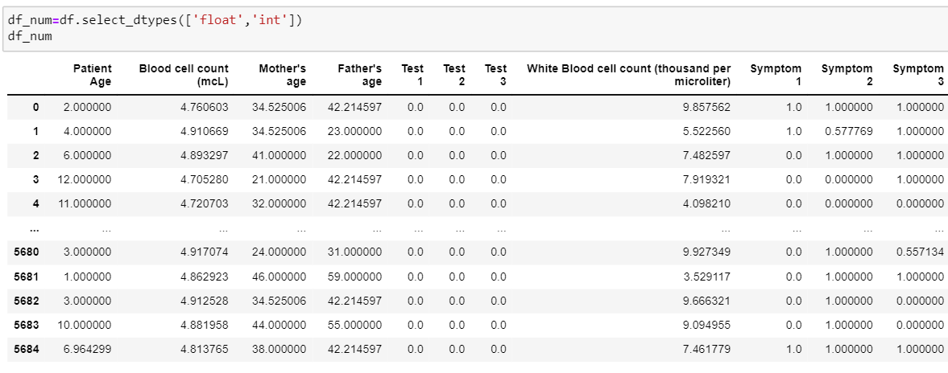
Separting Numeric and category Data

Slide 12
We are using label encoding to convert categorical data into numerical format.
Label encoding helps to transform categorical variables into a numerical representation, allowing these algorithms to work with categorical data.

Slide 13
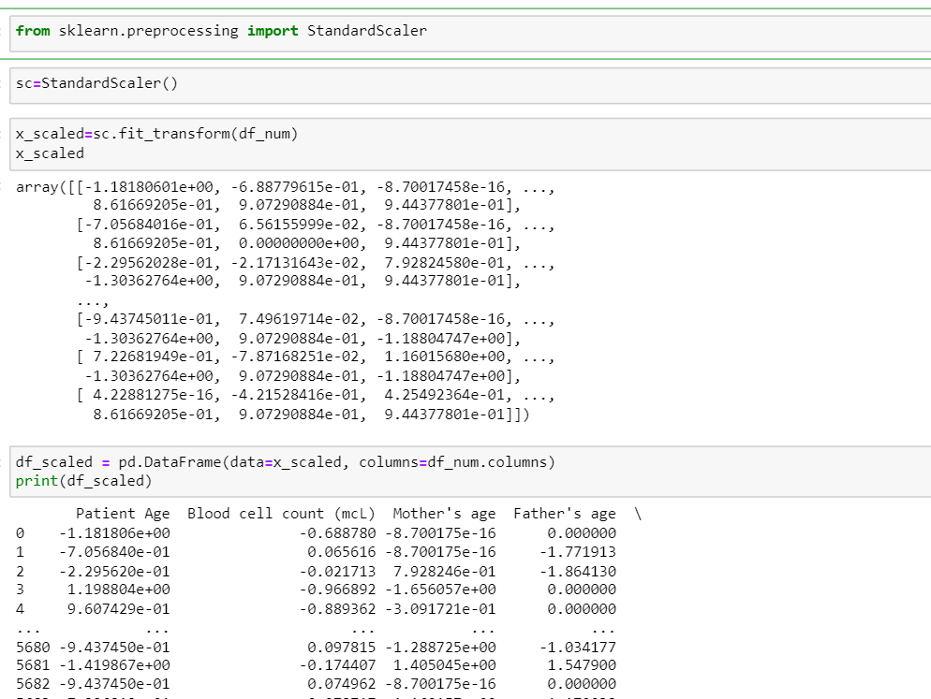
FEATURE SCALING Feature scaling is a preprocessing technique used in machine learning to standardize or normalize the range of independent variables or features in the dataset. It involves transforming the numerical values of features into a specific range to ensure that they have similar scales.

Slide 14
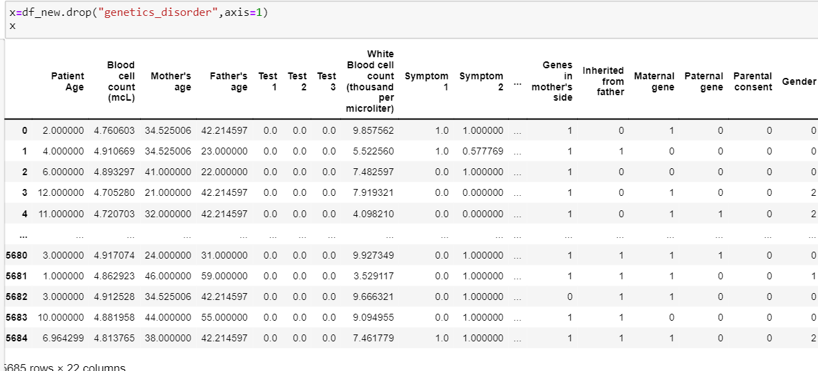
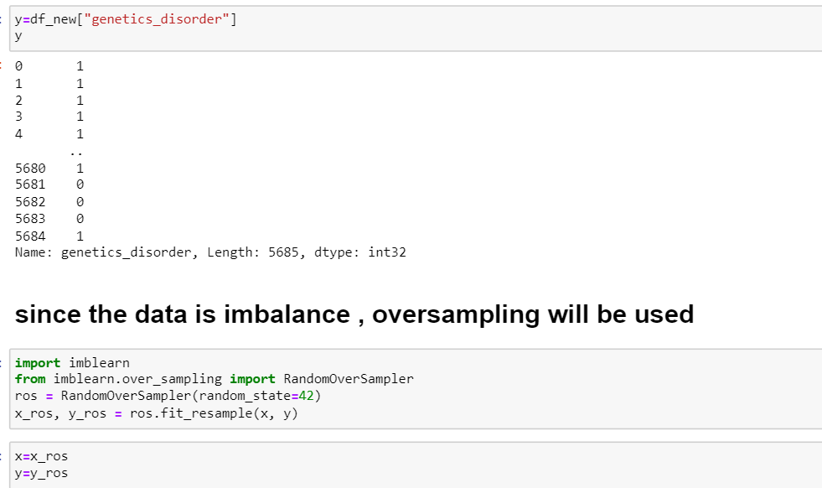
Split the data into features (X) , target variable(Y), test and train dataset
Since the data is imbalance we are using oversampling method.
Oversampling involves increasing the number of instances in the minority class by generating synthetic samples or replicating existing samples.

Slide 15

MACHINE LEARNING MODELS
Model training in machine learning refers to the process of using a dataset to train a machine learning model to make predictions or decisions based on input data. It involves fitting the parameters of the model to the training data, so that the model can learn patterns, relationships, and representations from the data.

Slide 16
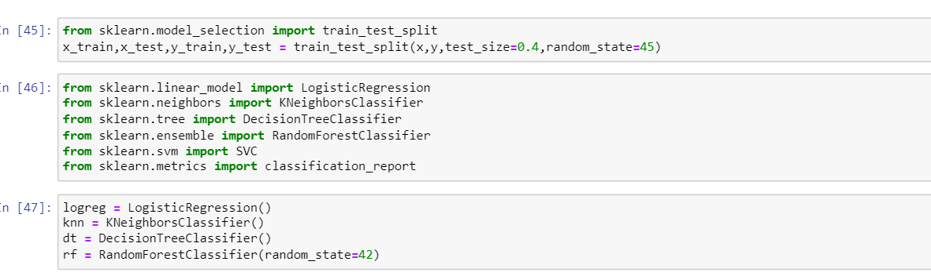
IMPORTING LIBRARIES

Slide 17
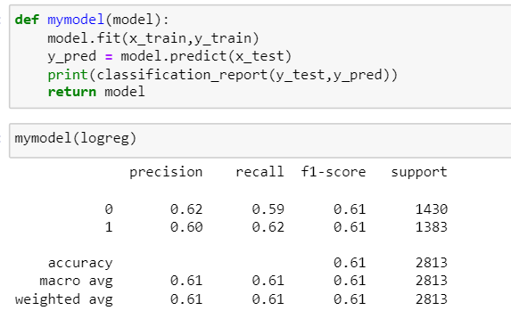
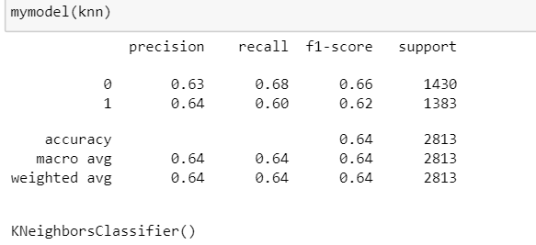
Logistic regression and KNN model
The logistic model gives the accuracy of 61% meanwhile KNN gives accuracy of 64%

Slide 18
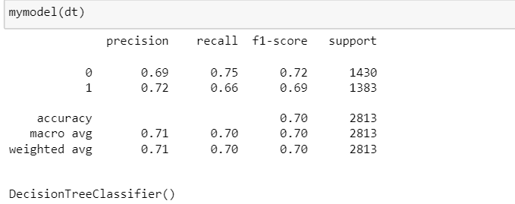
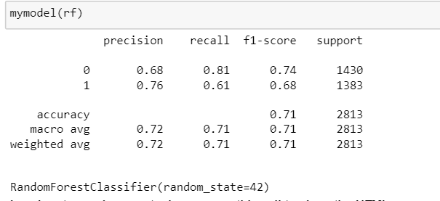
DECISION TREE AND RANDOM FOREST
Here we trained the data in decision tree and random forest, where we are getting 70% accuracy for decision tree and 71% for random forest.

Slide 19
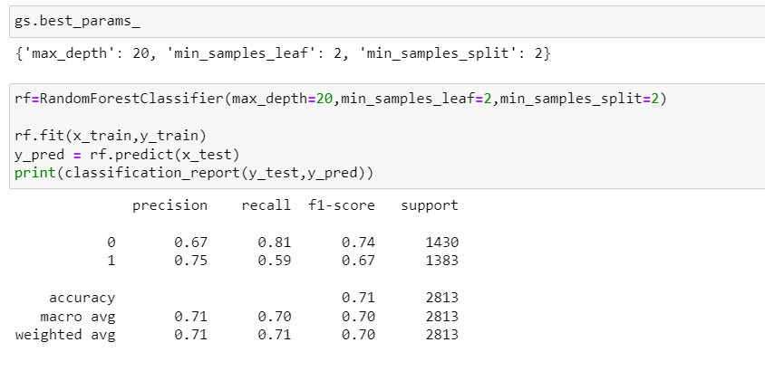
CONCLUSION
In this project, we build various models like logistic regression, knn classifier,decision tree classifier & random forest classifier
A Random Forest Classifier gives the highest accuracy score of 71.00 percent among all the ML Models.
Thus, for the Genetic disorder Prediction Dataset, the best accuracy can be achieved using Random Forest Model.

Slide 20

PRESENTED BY:- ANJALI ASHUTOSH TRIPATHI

